Slide 1
Strategies for Having Difficult Conversations

Slide 2
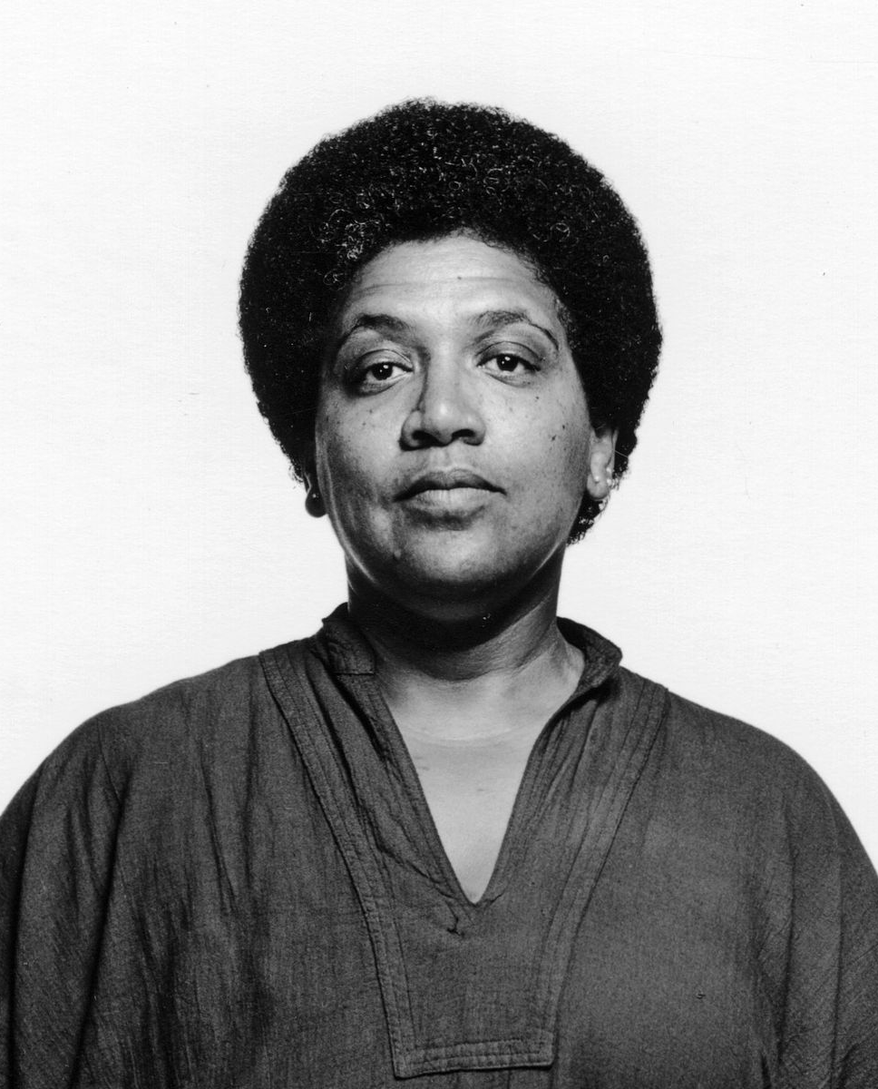
“When we speak, we are afraid our words will not be heard or welcomed. But when we are silent, we are still afraid. So it is better to speak.” –Audre Lorde

Slide 3
Day 1: Introduction
Welcome to the College of Pharmacy’s inaugural 21 Day Challenge! This voluntary learning opportunity provides a semi-structured shared experience through which everyone can engage in professional development related to inclusive excellence at their own daily pace. The topic was selected based upon staff feedback to ensure it is relevant and timely.
If you are not familiar with the 21 Day Challenge format, it is essentially a series of brief educational activities that are completed once per day. Research shows it takes 21 days to form a habit, so the goal of the experience is to not only raise awareness on a specific topic, but also get into the routine of thinking about it on a regular basis.

Slide 4
Day 1: Introduction (cont.)
This slide deck will serve as your guide for the 21 Day Challenge. Each day will focus on a particular topic and offer multiple options to choose from so you can opt in to whichever content interests you most. Similarly, each day will offer at least two ways to engage so that you can select which modality of delivery is optimal for your learning style and schedule.
Learning is a process that can be uncomfortable at times, including if we are not used to talking about it or because it hits close to home. As such, we invite you to engage with an attitude of curiosity while also respecting your own needs in the process.

Slide 5
Preparing for the Conversation

Slide 6
Day 1: Understand the Importance of Having Difficult Conversations
There are many reasons why it can be challenging to have hard conversations, especially in the workplace. However, if we allow our fears to stop us from trying to address important issues then they may never get resolved—and can even get worse. The College of Pharmacy recently released new Shared Values and Code of Conduct documents, both of which emphasize having crucial conversations for this exact reason. Being willing to strategically engage in challenging discussions helps us to live our values by ensuring everyone feels affirmed, investing in collegial relationships, and considering different points of view so we can identify the best solutions.
READ: Why Should I Have A Difficult Conversation?
WATCH: Avoiding Difficult Conversations Is Dangerous

Slide 7
Day 2: Discussion, Debate, and Dialogue
One of the most valuable tools we can utilize when preparing for a difficult conversation is determining what type of approach best fits everyone’s needs. When we consider in advance what the goals of having a difficult conversation are, we can set ourselves up for the best chance of success in cultivating effective communication.
READ: How Do I Choose Between Dialogue, Debate and Discussion to Explore Challenging Topics?
WATCH AND READ: Dialogue vs. Debate: Guidelines for Effective Dialogue

Slide 8
Day 3: Embrace a Growth Mindset
Research shows that changing how we think about ourselves and others can actually change human behavior. When preparing to have a difficult conversation, consider how embracing a growth mindset—rather than a fixed mindset—might help you lower the emotional stakes and equip you to persist through challenges that may arise.
READ: How to Leave Your Comfort Zone and Enter Your ‘Growth Zone’
WATCH: Developing a Growth Mindset
LISTEN: How to Adopt a Growth Mindset

Slide 9
Day 4: Practice Active Listening
Have you ever left an interaction feeling like you were heard but not truly listened to? This is a common experience in part because many of us have been taught to listen to respond rather than to better understand. We tend to distract ourselves with racing thoughts about what we’ll say next rather than really being in the moment and tuned in to what the other person is trying to express. Active listening can help us better understand those around us, but it is also a skill that requires practice.
READ: Did You Hear What I Said? How to Listen Better
WATCH: Improve Your Communication Skills Immediately with Active Listening

Slide 10
Proactively Mitigating Bias and Misunderstanding

Slide 11
Day 5: Account for Implicit Bias
Even with the best of intentions, sometimes our impact does not align with our goals. Implicit bias—also known as unconscious bias—is one mechanism through which we can unintentionally diverge from our stated beliefs, values, and goals. Accounting for the possibility of implicit bias within ourselves and others can assist us in understanding why and how some difficult conversations arise in the first place, as well as inform strategies for addressing them.
READ: How Does Implicit Bias Influence Behavior?
WATCH: How to Outsmart Your Unconscious Bias
LISTEN: Can We Unlearn Implicit Biases?

Slide 12
Day 6: Prevent and Clarify Misunderstandings
There are several additional strategies for preventing and clarifying misunderstandings that complement practicing active listening and accounting for implicit bias.
Check for understanding
“What I’m hearing you say is [X]? Is that right? I want to be sure I’m accurately understanding your point!”
“Is what I said clear? I know it was a lot all at once, so I’m happy to summarize the main points and answer any questions.”
Ask clarifying questions
“What do you mean by that?”
“Could you tell us more?”
“Can you point me to what evidence informed your decision-making process? I want to make sure I understand where you’re coming from since we seem to have reached such different conclusions.”
“I’m not familiar with that term, would you mind giving a quick definition?”

Slide 13
Day 6: Prevent and Clarify Misunderstandings (cont.)
Call for a pause in the interaction if needed
“We have been deep in this dialogue for awhile and I could use a moment to gather my thoughts and emotions. Would you be open to us taking a 15-minute break?”
“I want to continue this conversation, but I have a meeting in 5 minutes. Can we pause for now and reconvene later?”
Acknowledge the difficult nature of the conversation while reinforcing its value
“I know this meeting has probably felt intense because of the nature of the topic, so I want to thank you for staying engaged. I am confident we can find a solution to this exactly because we’re both committed to figuring it out together.”
“Thank you for agreeing to talk about this. I know the topic could feel anxiety-producing, so I want to assure you that I am only bringing it up because I know we are both invested in making our office as welcoming as possible.”

Slide 14
Day 7: Use Inclusive Language
One of the best ways to reduce the frequency of incidents that could lead to the need for hard conversations is to proactively use language that is inclusive. Yet many of us have never been taught the nuances of social identity terminologies and can therefore feel ill-equipped to even know where to start. Thankfully, employing principles of inclusive language can prepare us to learn ever-evolving terms.
READ: What is Inclusive Language in the Workplace? Examples, Steps, & Strategies
READ: Inclusive Language Guide
WATCH: Why Inclusive Language Matters

Slide 15
Day 8: Inclusive Language and Practice—Gender
One of the most pervasive ways that language choices can have subtle and overt implications is through use of gendered language. Considering not only our words but also how they may affect those around us—regardless of intention—can help prevent and address sexism in everyday life.
READ: The Hidden Sexism in Workplace Language
WATCH: Sexism and the English Language
WATCH: Gender Neutral Healthcare: How to be More Inclusive

Slide 16
Day 9: Inclusive Language and Practice—Race
Race and racism are arguably one of the most off-limits and/or intimidating topics for many people. For many other people, it is something they have been talking about their entire lives. Wherever you might fall in that spectrum, there are tools available to elevate your skills in talking about race and racism if you desire to know more about inclusive language and practice in this area.
READ: Antiracism Toolkit for Black, Indigenous, and People of Color
READ: Antiracism Toolkit for Allies
WATCH: Why Is It So Hard to Talk about Race?

Slide 17
Day 10: Inclusive Language and Practice—(Dis)Ability
Casual language contains a lot of implications around disability, ability status, and ableism that might not be obvious at first. Choosing to employ inclusive language and practice can help combat existing stigma around both physical and mental health.
READ: Why You Need to Stop Using These Words and Phrases
WATCH: Is It Okay to Say Disabled? What Is Ableism? What Is Disability?
LISTEN: Want To Be A Better Ally To Disabled People? Here’s How

Slide 18
Day 11: Inclusive Language and Practice—Religion
Because religion is often considered a out of bounds topic in public discourse, many of us have not had abundant opportunities to learn about religious and/or spiritual beliefs different from our own—much less how to speak about them or consider implications for our own professional practice.
READ: Guides to Islamic Religious Practices
For Employers
For Healthcare Providers
For Educators
READ: Ask the Expert: Jews in the Hospital
READ: Healthcare Providers’ Handbook on Hindu Patients

Slide 19
Day 12: Inclusive Language and Practice—Size
Our society constantly sends implicit and explicit messages about body types and size. The (de)valuing of different types of bodies is often referred to as sizeism, weight stigma, or fatphobia. A lot of these messages are sconced in concerns about health—especially when we work in health sciences college. Consider learning about how the language of such messages can affect individuals regardless of the intention behind them.
READ: Why I No Longer Prescribe Weight Loss, Calculate BMI, or Use the Term “Obesity”
READ: 3 Ways Public Health Professionals Can Combat Weight Stigma
WATCH: The Very Real Consequences of Weight Discrimination

Slide 20
Day 13: Address Microaggressions
You have likely heard the word microaggressions, which is a research-based term for the commonplace, everyday behaviors that intentionally or unintentionally communicate negative and/or prejudiced attitudes toward members of marginalized social identity groups. When we are aware of and committed to interrupting microaggressions, we can prevent some difficult conversations from being necessary in the first place, as well as stop harm that is happening from escalating further.
READ: Addressing Microaggressions to Deliver Cultural Competence in Pharmacy
WATCH: How Microaggressions Are Like Mosquito Bites
WATCH: How To Hold Yourself Accountable After Committing A Microaggression
LISTEN: Upstanders: Standing Up Against Microaggression

Slide 21
Having the Conversation

Slide 22
Day 14: Differentiate Intent and Impact
You have likely heard the phrase, “assume best intentions.” Starting from a place of believing that colleagues are not purposefully trying to create issues can be helpful for many reasons. At the same time, someone’s impact does not always align with those good intentions. Reasons for this disconnect can include implicit bias, misunderstandings, unclear communication, etc. As such, it is vital to understand that intent and impact are different even while they are interrelated.
WATCH: Intent v. Impact
READ: Assume Positive Intensifies

Slide 23
Day 14: Differentiate Intent and Impact (cont.)
Thankfully, there are actionable ways to recognize both intent and impact while having crucial conversations. Here are a few possible scripts for proactively honoring positive intentions while also addressing an impact that is not ideal:
“I know that you care deeply about [topic], which is exactly why I wanted to talk to you about your comment. Even though you surely did not mean for [implication], the outcome is still that [consequences].”
“I’m surprised to hear you say that because I know how much you value our students. I assume you did not mean anything negative by it, but have you thought about how a student might feel if they overheard you making that comment? It could easily be misinterpreted, and I know you would never want to accidentally cause harm in that way.”

Slide 24
Day 15: Prepare for and Normalize Emotionality
One of the biggest reasons we sometimes avoid potentially difficult interactions is concern that we or others will get emotional. Remind yourself that emotions not inherently good or bad but they are an important part of what makes us human. Rather than avoiding emotionality, courageous conversations recognize feelings will inevitably arise and that we are capable of managing them when they do.
READ: Emotion Regulation
READ: How to Stabilize Emotions in Difficult Conversations
WATCH: How to Manage Emotions during Difficult Conversations with Employees

Slide 25
Day 16: Invite People to Travel with You
We cannot know what we do not know until someone informs us. All of us are on a continual learning journey, whether we are relatively new to or very experienced with having difficult discussions. One way we can invite others to continue learning with us is by modeling that there is no shame in not knowing but there is pride in being willing to learn. When we humbly acknowledge our own learning experiences—including the fact that at some point we ourselves did not know something that we are now trying to share with others—it can lower the natural defensiveness that can come with feeling challenged.

Slide 26
Day 16: Invite People to Travel with You (cont.)
Share your own experience
“If I’m being honest, I also did not know that word was generally not considered appropriate until a friend pointed it out to me recently. So I’m trying to pass along the knowledge because I know I was certainly surprised to learn it.”
“I know when I first learned about implicit bias, I was skeptical. But the more I learned, the more I realized it’s not only based in science but also an important topic since it affects all of us in some way or another.”
Assure others that they are not alone on this learning journey
“I know this might be a lot to think about, so if you want some time to process then I completely understand. Whenever you do want to delve into it more, though, I am here for you! I would love for this to be a two-way street where we are both continually learning alongside each other.”

Slide 27
Day 17: Avoid Tone Policing
Tone policing is when someone criticizes the emotional way in which a person has expressed their point of view instead of grappling with the actual substance of their message. In other words, sometimes we focus on the delivery style of the messenger more than the content of the message itself, which can lead to missing the point altogether. How can we stay focused on better understanding what someone is trying to communicate instead of getting upset that they are passionate about what they are saying?
READ: Dealing with Tone Policing
READ: Tone-Policing and the Assertion of Authority
WATCH: Tone Policing Scenario
LISTEN: Tone Policing: Problematic Prejudice or Reasonable Request for Respect?

Slide 28
Day 17: Avoid Tone Policing (cont.)
Even when you are aware of what tone policing is and how it can show, it can still require conscious effort to avoid it when an interaction feels emotionally heightened. Here are a few strategies to consider:
Recognition is vital
Familiarize yourself with common tactics, such as telling a person to calm down or rephrase their message for palatability
Do not invalidate emotions
Ask yourself, “Am I trying to change the subject because I am feeling uncomfortable, called out, implicated, etc.? Why am I feeling that?”
Normalize the expression of anger and other emotions
Remember that expressing emotions is natural and no emotion is inherently bad
Remind yourself that this person is trusting you to hear how they really feel and think about a deeply personal experience
Recognize that the emotions expressed may be reflective of a lifetime of experience rather than a single incident

Slide 29
Continuing the Conversation

Slide 30
Day 18: Persist Through Disagreement
Employing strategies for having hard conversations maximizes the likelihood that they will have a positive outcome. However, no strategy can completely ensure that there will be no disagreement in the process—nor, arguably, should it. But when many of us have been socialized to perceive any form of conflict as a negative experience to be avoided at all costs, then how can we prepare ourselves to persist through possible disagreement and continue when the conversation gets challenging?
READ: Why We Should Be Disagreeing More at Work
WATCH: Finding Confidence in Conflict

Slide 31
Day 19: Consider Restorative Justice Approaches
Our society often relies upon punitive measures to address behavior that harms others. However, this is not the only possible approach. Restorative justice offers an alternative framework that can be beneficial in the workplace, classroom, laboratory, clinic, and beyond. When our goal is to repair harm and repair relationships, restorative justice can be an invaluable approach to having difficult conversations.
READ: The Philosophy and Principles of Restorative Justice
READ: Restorative Justice in the Workplace Fosters a Caring Work Environment
WATCH: Introduction to Restorative Justice

Slide 32
Day 20: Know Your Resources
No matter how much care and consideration we put into having a difficult conversation, sometimes it does not go as planned. If a difficult conversation escalates, turns into a larger issue, or otherwise requires additional addressal then there are various resources available to you. In addition to consulting with your supervisor, Human Resources, and/or the Office of Inclusive Excellence as appropriate, Ohio State also houses offices and initiatives geared toward mediation, restorative justice, civil discourse, and reporting.
Office of Student Life Student Mediation Program
Office of Inclusive Excellence Restorative Justice Initiative
Office of Ombuds Services
Office of Institutional Equity

Slide 33
Day 21: Continue Your Learning Journey
Hopefully, you feel better equipped and empowered to navigate difficult conversations now that you have engaged with this 21 Day Challenge. At the same time, learning is a lifelong process. There are several campus offerings geared toward continued learning on similar topics.
Center for Ethics and Human Values
The 4Cs of Civil Discourse Free Online Course
Workshops and Facilitated Dialogues
Michael V. Drake Institute for Teaching and Learning
Ethical Disagreement and Civil Discourse Teaching Endorsement
Moritz College of Law Divide Communities Project
Fostering Compassionate Dialogue on Campus

Slide 34
Day 21: Continue Your Learning Journey (cont.)
REFLECT: What has been the most valuable, surprising, and/or challenging content for you to engage with during this experience? Why might it have been particularly meaningful to you?
REFLECT: What is one concrete action that you will incorporate into your practice, teaching, and/or research now that you have spent 21 days learning about having difficult conversations?

Slide 35
“Not everything that is faced can be changed, but nothing can be changed until it is faced.” –James Baldwin

Slide 36
Thank You!

